Slide 1
Evaluation of the 2016/17 BEPPs of
South Africa’s 8 Metropolitan Municipalities

Slide 2
Background

Slide 3
2016/17 BEPP is expected to be a progression from 2015/16
2014/15
The focus of the BEPP processes was on planning methodology for spatial transformation
2015/16
Packaging and accelerating the implementation of a pipeline of catalytic urban development projects within the integration zones
2016/17
* Spatial Planning and Project Prioritisation
* Intergovernmental Project Pipeline
* Capital Funding
* Implementation
* Urban Management
Evaluation of the 2015/16 BEPPs have highlighted the following deficiencies and inconsistencies in the Capital Funding models and strategies of the metro BEPPs
Limited or no alternate funding considerations
High reliance on Grants and Borrowings
Limited Public Private Partnership initiatives
Limited information to evaluate the bankability and feasibility of the projects
Unable to determine status of financial closure due to limited information on funding arrangements
Lack of sufficient detailed, project specific information to determine bankability and feasibility in BEPP document

Slide 4
2015/16 Evaluation revealed Significant Dependency on Grant Funding
National Treasury has emphasised that what metros borrow for, should be for revenue generating infrastructure - which in the longer term will decrease dependence on grant funding and external loans
The typical funding split for Capital Projects in 2015/16 was:
Grant funding
(30- 90%)
Too High
External loans
(15 – 45%)
Own revenue
(5-30%)
Too Low

Slide 5
Capital Funding in the context of the BEVC
Spatial Planning & Project Preparation
Intergovernmental Project Pipeline
Capital Funding
Implementation
Reporting & Evaluation
Urban Management
Institutional Arrangements & Operations Budgeting
The planning approach should clearly influence the allocation of capital funding, and result in service delivery implementation, which in turn requires urban management to protect and sustain public and private investment
Capital funding is probably the largest, single constraint to implementation of the plan
Crucial that Metros follow a refined, robust capital funding process which:
provides sufficient inputs for investment decision-making; and
guides the allocation of limited funds to unlimited demands

Slide 6
DBSA Objective: To conduct an analytical review of the Cities Built Environment Performance plan and recommend intervention strategies
Focus: Annual technical desktop review of BEPPs to assess how effectively and efficiently BEPPs are financed at an institutional and programme/project pipeline level in terms of the Guidance Note
Guidance Note for the Built Environment Performance Plan
(BEPP) 2016/17 – 2018/19
BEPPs should clearly articulate the long term financing need and strategy for spatial transformation
This financing strategy should be based on the plan for spatial transformation
The long term financial strategy provides the framework for investment activities that relate specifically to the financing of projects within Integration Zones
The Draft BEPP should acknowledge the existence, or lack thereof of a long term financing strategy, and the Final BEPP must clearly state the commitment to the formulation of a long term financing strategy within a specific timeframe
Source: Built Environment Performance Plans (BEPPs) Guidance Note for 2016/17 – 2018/19,
Issued on 21 October 2015 (First Draft issued 31/08/2015; Second Draft 17/09/2015).
Notes:
Looking at the visions of the major municipalities in South Africa we see that they are all largely aligned around the same key themes of sustainability, economic success and human and societal development
And these are all ambitious visions…

Slide 7
Purpose of the evaluation
To assess the extent to which proposed programmes and projects in the Built Environment Performance Plans (BEPPs) by Metropolitan Cities can be financed
Progress to date
The Built Environment Performance Plans (BEPPs) are now in the third cycle since the inception of the City Support Programme (CSP).
Cities have made remarkable improvements in the articulation of strategic objectives and have provided a range of approaches to realise these goals.
Financial closure?
However, the extents to which these plans have achieved financial closure at programme and project level remains a concern.
A review of the BEPPs is required to test if the resources are likely to match the ambitions.
Achieving catalytic goals
This is part of the process of moving the system into the implementation phase and supporting the Cities to prioritise catalytic projects for project packaging and financing
Notes:
Looking at the visions of the major municipalities in South Africa we see that they are all largely aligned around the same key themes of sustainability, economic success and human and societal development
And these are all ambitious visions…

Slide 8
Approach

Slide 9
Key evaluation activities
Assessment of the Capital Funding and financial information contained in each of the current BEPPs
* (information that would attract funders and private investors to invest in the BEPP Project pipeline)
Rating of Quality of current BEPPs
Recommendations on key information which should be reflected in the 2017/18 BEPPs
* (to improve the financial closure of the BEPP); and
* (to be financeable and bankable)

Slide 10
The framework within which Bankability Evaluations are performed
Bankability simply means lenders are comfortable to lend money to the project because it is:-
Underpinned by sound financial and market information, which means it’s able to generate enough cash flows to service the financing and still be profitable
Underpinned by sound technical and institutional arrangements which gives it longevity and sustainability
In order to do a Bankability Assessment, evidence of the following is required:-
Appropriately formulated, designed and structured plan for the infrastructure to be provided (e.g. as a PPP, Corporate, Project Finance or a hybrid– Business Plan
Sufficient technical studies and investigations to ensure accurate cost estimates and to address the project risks. - Pre-feasibility Studies/Concept Plans
The project design and structure should address all the major project risks (with risks allocated to the parties most suitable to mitigate the risk). Business Plan

Slide 11
The typical Criteria used to assess Financeability/Bankability
Project Funding Criteria used by Development Finance Institutions
Economic / Commercial viability
Long term sustainability of the market opportunity
Positive development impacts
• Financial / Technical viability
Financially viable projects able to service debt and/or equity commitments
Business access for local SMME entrepreneurs (e.g. Procurement)
Optimal use of local labour and material
• Institutional Capacity
Managerial/human resources capacity to implement project successfully
Systems capacity
• Legal and Regulatory Compliance
Compliance with application legislation and regulations
• Social and Environmental soundness
Governance and controls

Slide 12
Reference: BEPP Guidelines 2016/17 iro Section D. Capital Funding
High level allocation of capital budget to each of the following 3 spatial targeting categories in terms of total capital budget from all funding sources:
Investment strategy for intergovernmental project pipeline
Leadership, good governance and planning (strategic & operational)
Risk mitigation strategies
Operating budget implications
City Support Implementation Plan
Inter-sectoral municipal & consultation with PG, SOE’s & National Departments responsible for asset creation for service delivery directly to the public (e.g. SAPS)
Urban Network identification and prioritisation of Integration Zones
Marginalised areas (Informal settlements, Townships and Inner City Areas)identification and prioritisation
Growth nodes (commercial and industrial) identification and prioritisation
D1. Spatial budget mix
D2. Investment strategy
D3. Institutional arrangements and operating budget

Slide 13
Focus areas of this evaluation
Metro’s borrowing capacity and high level financial health
Availability of a long term financing strategy for spatial transformation
Project/programme pipeline detailed information (including status of projects)
Estimated project costs/value
Confirmed funding sources over the MTREF cycle
Alternative funding sources, if any
Availability of risk management strategy

Slide 14
Evaluation and Recommendations

Slide 15
Capital Funding Requirements
Capital Funding Mix
 | Grants | External loans | Own Revenue | Capital Budget
Buffalo City | 925 | - | 425 | 1,350
Nelson Mandela Bay | 1,032 | - | 565 | 1,597
Mangaung | 793 | 1,072 | 527 | 2,392
Ekurhuleni | 2,200 | 1,812 | 945 | 4,957
City of Johannesburg | 2,891 | 2,506 | 4,454 | 9,851
City of Tshwane | 2,507 | 1,200 | 285 | 3,992
eThekwini | 3,682 | 1,000 | 1,753 | 6,435
City of Cape Town | 2,382 | 1,500 | 845 | 4,727
Total | 16,412 | 9,090 | 9,799 | 35,301
Consolidated Capital Funding Mix
 | Grants | External loans | Own Revenue | Capital Budget
% | 46 | 26 | 28 | 100
Total | 16,412 | 9,090 | 9,799 | 35,301
There remains a large dependency on Grant funding (46%);
Whilst 28% of Capital Funding is through Own Revenue, COJ contributes 45% to this total;
26% of Capital Funding is reliant on the raising of external loans
Source: National Treasury Database: Budget MTEF 2015/16

Slide 16
Capital Funding Requirements
Planned External Loans
Municipality | External loans
Mangaung | 1,072
Ekurhuleni | 1,812
City of Johannesburg | 2,506
City of Tshwane | 1,200
eThekwini | 1,000
City of Cape Town | 1,500
Total | 9,090
It is projected that over R9bn (26%) of Capital Funding will be acquired through External Loans;
Failing which, implementation of catalytic projects, will be severely constrained;
It is crucial that Metros follow a refined, robust Capital Funding process which:
provides sufficient inputs for investment decision-making; and
guides the allocation of limited funds to unlimited demands
BEPPs must therefore contain sufficient information regarding the degree of financial closure in respect of these external loan applications
Source: National Treasury Database: Budget MTEF 2015/16

Slide 17
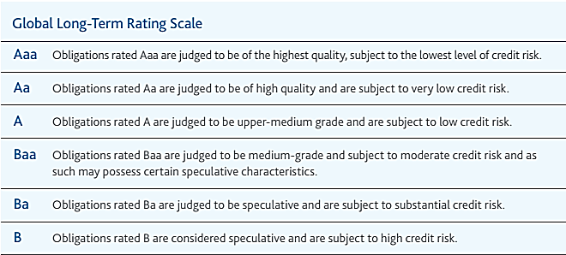
1. Evaluation of Metro Financial Status and Borrowing Capacity Capacity
Credit Ratings
Purpose:
To provide investors with a simple system of gradation by which future relative creditworthiness of securities may be gauged.
Municipality | MAN | TSH | CPT | NMB | ETK | BCM | EKU | COJ
Credit rating (Moody’s) *GCR: Global Credit Rating | Ba1 Outlook negative | Ba1 Outlook negative | Baa2 Outlook negative | Baa2 Outlook negative | AA- *(GCR) | Ratings withdrawn since 2012 | Baa2 Outlook negative | Baa2 Outlook negative
Overall assessment is that the outlook is negative, and because of the substantial credit risk, it will become difficult to attract investors, that is, to raise capital funds
Poor
Average
Good
Excellent
Source: Schedule SA8, 2016/17 MTREF of each Metro

Slide 18
Evaluation of Metro Financial Status and Borrowing Capacity
Recommendations: Credit Ratings
The name of the agency responsible for the credit rating must be disclosed in relevant documentation to facilitate verification of the rating.
The discrepancy between the credit ratings disclosed in SA8 and Moody’s must be resolved. This discrepancy generates uncertainty in the minds of potential investors
Schedule SA8, which includes the credit ratings, should be incorporated into the BEPP for ease of reference
Long-term financial strategies must be developed with the objective of improving current credit ratings which will make investment in catalytic capital infrastructure programmes and projects attractive to investors.

Slide 19
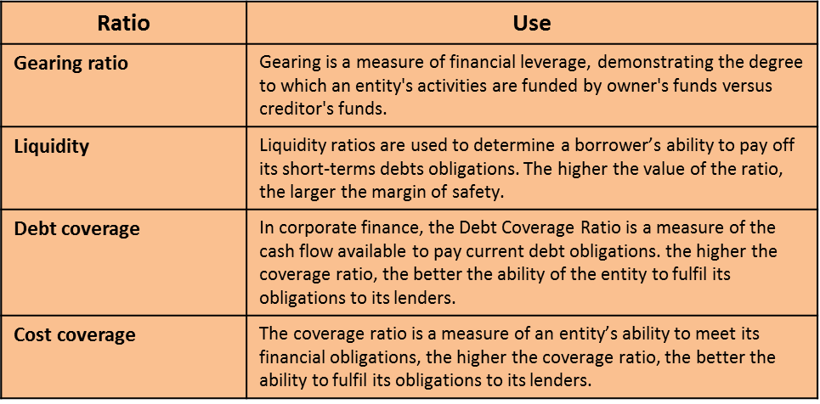
Evaluation of Metro Financial Status and Borrowing Capacity
Financial ratios
Purpose:
To enable investors to assess the relative strength of investments by performing simple calculations on items on income statements, balance sheets and cash flow statements
Municipality | MAN | TSH | CPT | NMB | ETK | BCM | EKU | COJ
Gearing Long Term Borrowing/ Funds & Reserves | 108.4% | 4412.5% | 437.2% | ? | 75.3% | 14.8% | 550.6% | ?
Liquidity ratio Monetary Assets/Current Liabilities | .3 | .5 | .3 | .3 | .7 | 2.7 | 1.5 | .2
Debt coverage (Total Operating Revenue - Operating Grants)/ Debt service payments due within financial year | 16.3 | 27.5 | 28.4 | ? | 14.5 | 19 | 28.6 | 10.5
Cost coverage (Available cash + Investments) / monthly fixed operational expenses | 1.8 | 1.5 | .4 | ? | 2.5 | 7.5 | 4.3 | 1.1
Whilst financial ratios are used in conjunction with a number of other financial analysis tools, Ekurhuleni and Buffalo City, have to a large extent, solid ratios in almost all instances, which will be attractive to potential investors
Source: Schedule SA8, 2016/17 MTREF of each Metro
Notes:
Ratio
Use
Gearing ratio
Gearing is a measure of financial leverage, demonstrating the degree to which an entity's activities are funded by owner's funds versus creditor's funds.
Liquidity
Liquidity ratios are used to determine a borrower’s ability to pay off its short-terms debts obligations. The higher the value of the ratio, the larger the margin of safety.
Debt coverage
In corporate finance, the Debt Coverage Ratio is a measure of the cash flow available to pay current debt obligations. the higher the coverage ratio, the better the ability of the entity to fulfil its obligations to its lenders.
Cost coverage
The coverage ratio is a measure of an entity’s ability to meet its financial obligations, the higher the coverage ratio, the better the ability to fulfil its obligations to its lenders.

Slide 20
Evaluation of Metro Financial Status and Borrowing Capacity
Recommendations: Financial ratios
The relevance, use and accuracy of the ratios reflected in schedule SA8 should be reviewed and revised as necessary.
The revised Schedule SA8, including relevant financial ratios, should be incorporated into the BEPP for ease of reference
Metros must investigate the gearing ratio calculation, which reflects the amount of existing equity that would be required to pay off all outstanding debts.
Metro documents reflect very high gearing ratios, and entities with ratios upward of 50% for example, represent a greater risk, because even a brief period of a sudden increase in interest rates could mean significant cash flow constraints and potential loan default.
The cause of suboptimal financial ratios must be investigated in detail and short and long-term financial strategies must be developed with the objective of improving financial efficiency and effectiveness which will promote investor confidence in investing in catalytic capital infrastructure programmes and projects attractive to investors.

Slide 21
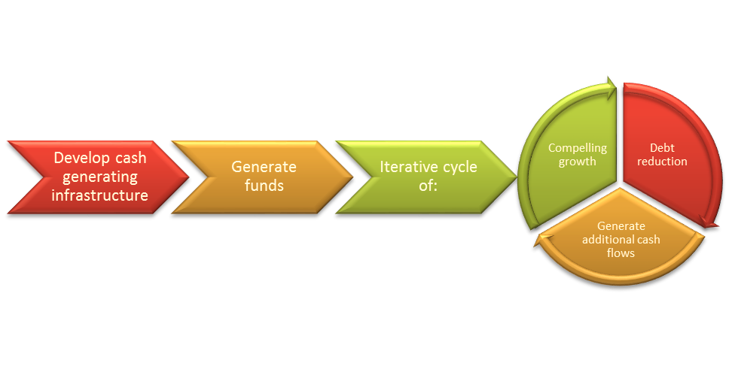
Evaluation of Metro Financial Status and Borrowing Capacity
Cash generating project pipeline
Goal:
To prioritise catalytic projects which are cash generating thereby generating own and alternate funding for other catalytic projects
Municipality | MAN | TSH | CPT | NMB | ETK | BCM | EKU | COJ
Cash generating project pipeline
Unable to determine from the BEPP which are cash generating projects and which future projects will benefit from the funds generated from these projects
Notes:
Ratio
Use
Gearing ratio
Gearing is a measure of financial leverage, demonstrating the degree to which an entity's activities are funded by owner's funds versus creditor's funds.
Liquidity
Liquidity ratios are used to determine a borrower’s ability to pay off its short-terms debts obligations. The higher the value of the ratio, the larger the margin of safety.
Debt coverage
In corporate finance, the Debt Coverage Ratio is a measure of the cash flow available to pay current debt obligations. the higher the coverage ratio, the better the ability of the entity to fulfil its obligations to its lenders.
Cost coverage
The coverage ratio is a measure of an entity’s ability to meet its financial obligations, the higher the coverage ratio, the better the ability to fulfil its obligations to its lenders.

Slide 22
Evaluation of Metro Financial Status and Borrowing Capacity
Recommendations: Cash generating project pipeline
Metros should identify and prioritise investment in cash generating projects
Metros should incorporate the estimates of funds to be generated from these investments into their financial strategies, cash flow projections and planning the rollout of subsequent projects
Cash generating projects, should be clearly identified, and disclosed in the BEPP detailing projected cash flows and planned use of these funds

Slide 23
Evaluation of Metro Financial Status and Borrowing Capacity
Availability of long term financial strategy
Purpose:
Long-term financial strategies use forecasts to provide insight into future financial capacity so that strategies can be developed to achieve long-term sustainability in light of the government's service objectives, financial challenges and the overall catalytic infrastructure demands.
Mobilisation phase
Analysis phase
Decision phase
Execution phase
Key phases in Development of a Finance Strategy
Municipality | MAN | TSH | CPT | NMB | ETK | BCM | EKU | COJ
Availability of a long-term financial strategy
Metros are at different levels in respect of the development of a long-term financial strategy - some are still in the process of developing a strategy whilst others are utilising the strategy in the rollout of infrastructure projects
Notes:
Ratio
Use
Gearing ratio
Gearing is a measure of financial leverage, demonstrating the degree to which an entity's activities are funded by owner's funds versus creditor's funds.
Liquidity
Liquidity ratios are used to determine a borrower’s ability to pay off its short-terms debts obligations. The higher the value of the ratio, the larger the margin of safety.
Debt coverage
In corporate finance, the Debt Coverage Ratio is a measure of the cash flow available to pay current debt obligations. the higher the coverage ratio, the better the ability of the entity to fulfil its obligations to its lenders.
Cost coverage
The coverage ratio is a measure of an entity’s ability to meet its financial obligations, the higher the coverage ratio, the better the ability to fulfil its obligations to its lenders.

Slide 24
Evaluation of Metro Financial Status and Borrowing Capacity
Recommendations: Availability of long term financial strategy
All metros should develop long-term financial strategies as a matter of urgency, and take into consideration the following:
Time Frame - at least five to ten years into the future.
Scope - should consider all appropriated funds, but especially funding related to capital expenditure for catalytic infrastructure projects
Frequency - should be updated as needed in order to provide direction to the budget process
Content - should include:
an analysis of the financial environment;
revenue & expenditure forecasts;
debt position & affordability analysis;
strategies for achieving & maintaining financial balance; and
plan monitoring mechanisms, such as scorecard of key indicators of financial health
Visibility - should devise an effective means for communicating this information, through either separate plan documents or by integrating it with existing communication devices.
Relevant sections of the long-term financial strategy should be included in the BEPP, especially where this is of significance to a potential investor

Slide 25
Evaluation of Metro Financial Status and Borrowing Capacity
Funding mechanism (on or off balance sheet)
Rationale:
Off balance sheet items are of particular interest to investors trying to determine the financial health of a company. These items are harder to track, and can become hidden liabilities.
Off Balance Sheet items
Joint Ventures
Derivatives
Partnerships
Operational leases
Sale of receivables
Securities
Special purpose entities
Municipality | MAN | TSH | CPT | NMB | ETK | BCM | EKU | COJ
On or off balance sheet items
Unable to determine from the BEPP whether there are off balance sheet arrangements or the value of this exposure or the potential risk of such legal agreements
Notes:
Ratio
Use
Gearing ratio
Gearing is a measure of financial leverage, demonstrating the degree to which an entity's activities are funded by owner's funds versus creditor's funds.
Liquidity
Liquidity ratios are used to determine a borrower’s ability to pay off its short-terms debts obligations. The higher the value of the ratio, the larger the margin of safety.
Debt coverage
In corporate finance, the Debt Coverage Ratio is a measure of the cash flow available to pay current debt obligations. the higher the coverage ratio, the better the ability of the entity to fulfil its obligations to its lenders.
Cost coverage
The coverage ratio is a measure of an entity’s ability to meet its financial obligations, the higher the coverage ratio, the better the ability to fulfil its obligations to its lenders.

Slide 26
Evaluation of Metro Financial Status and Borrowing Capacity
Recommendations: Funding mechanism: off balance sheet arrangements
Metros should disclose off balance sheet arrangements under the following conditions:
the risks or benefits arising from arrangements are material;
only to the extent necessary for enabling the financial position of the company to be assessed, particularly by potential investors
Metros should factor the potential impact of these arrangements into the calculations of their financial ratios, where appropriate
Material off balance sheet items should be disclosed in the BEPP, with an indication of the benefits and risks, if applicable, of such arrangements

Slide 27
Evaluation of Project Pipeline and Funding
Systematic identification, prioritisation and allocation
Goal:
Finding and selecting the right catalytic projects and developing a valuable project pipeline are crucial to success.
To be successful, the project identification, prioritisation and allocation process must be well defined and disciplined, addressing the most critical demands faced by the metro in a systematic way
Municipality | MAN | TSH | CPT | NMB | ETK | BCM | EKU | COJ
Pipeline of projects clearly identified
Project feasibility/pre-feasibility conducted
Project pipeline fully costed over the MTREF
Funding sources indicated/identified (grants, own revenue, borrowing)
Alternative funding sources identified
Project pipeline status
Overall Rating
This evaluation was based on a desktop review of Part D. Capital Funding of the BEPP.
An extended evaluation, to include a review of business cases, programme and project plans, dependencies and interdependencies, prioritisation & decision matrices and funding requirements, may lead to a different evaluation to the one reflected above.
Poor
Average
Good
Excellent
Notes:
Ratio
Use
Gearing ratio
Gearing is a measure of financial leverage, demonstrating the degree to which an entity's activities are funded by owner's funds versus creditor's funds.
Liquidity
Liquidity ratios are used to determine a borrower’s ability to pay off its short-terms debts obligations. The higher the value of the ratio, the larger the margin of safety.
Debt coverage
In corporate finance, the Debt Coverage Ratio is a measure of the cash flow available to pay current debt obligations. the higher the coverage ratio, the better the ability of the entity to fulfil its obligations to its lenders.
Cost coverage
The coverage ratio is a measure of an entity’s ability to meet its financial obligations, the higher the coverage ratio, the better the ability to fulfil its obligations to its lenders.

Slide 28
Evaluation of Project Pipeline and Funding
Recommendations: Systematic identification, prioritisation and allocation
The recommendations below must be interpreted with due consideration of the limitations of the current desktop evaluation. An extended evaluation may lead to a modification of the recommendations below.
It is recommended that BEPPs be standardised across all metros based on those of a high quality e.g. CPT
It is recommended that comprehensive detail be provided for all of the following components in Part D. Capital Funding of the BEPP:
Pipeline of projects
Indicate whether a project feasibility/pre-feasibility has been conducted
Project pipeline fully costed over the MTREF
Funding sources identified (grants, own revenue, borrowing) and status of financial closure in this respect
Identify alternative funding sources, and status of financial closure in this respect
Highlight projects for which funding has not been acquired/ secured
Indicate next steps in respect of “unbanked” projects
Indicate status of project pipeline

Slide 29
Evaluation of Risk Identification and Mitigation
Availability of risk management strategy
Objective:
Risk is inherent in all activities of any large scale
infrastructure project. To be successful, a risk management process is needed such that risk can be
continually evaluated and managed in order to minimise the consequences of adverse events.
Key steps in the Risk Management Process
Risk Management Planning
Risk Identification
Risk Assessment
Risk Reporting and Tracking
Risk Handling
Risk Management Impact and Control Actions
Municipality | MAN | TSH | CPT | NMB | ETK | BCM | EKU | COJ
Identification of risks
Mitigation of risks
The current BEPPs do not appear to provide inputs on the risks that have been identified or the strategy to mitigate these risks
Notes:
Ratio
Use
Gearing ratio
Gearing is a measure of financial leverage, demonstrating the degree to which an entity's activities are funded by owner's funds versus creditor's funds.
Liquidity
Liquidity ratios are used to determine a borrower’s ability to pay off its short-terms debts obligations. The higher the value of the ratio, the larger the margin of safety.
Debt coverage
In corporate finance, the Debt Coverage Ratio is a measure of the cash flow available to pay current debt obligations. the higher the coverage ratio, the better the ability of the entity to fulfil its obligations to its lenders.
Cost coverage
The coverage ratio is a measure of an entity’s ability to meet its financial obligations, the higher the coverage ratio, the better the ability to fulfil its obligations to its lenders.

Slide 30
Evaluation of Risk Identification and Mitigation
Recommendations: Availability of risk management strategy
All metros should develop risk management strategies as a matter of urgency, with the following characteristics:
a comprehensive conceptual framework that introduces risk management across the value chain and highlights the most critical issues and design choices to be made;
a strong set of practical approaches and tools that will enable the metro to make these design choices and manage risks more proactively and thus more effectively;
an implementation framework that effectively introduces and ensures the application and execution of discipline in day-to-day business, starting in the beginning of the design phase all the way through the life cycle of the project
High-level risks, as well as the mitigation plans, should be included in the BEPP, especially where this is of significance to a potential investor

Slide 31
Conclusion

Slide 32
Conclusion
The significant progress that has been made in the development of the BEPPs should be sustained and enhanced , with the focus shifting towards to Capital Funding
The following additional financial information, or extracts thereof, should be incorporated into the BEPP to enhance its value:
These requirements should also be detailed in the National Treasury BEPP Guidance Note
Credit ratings
Financial Ratios (Schedule SA8)
Cash generating investments
Long-term financial strategies
Off balance sheet arrangements
Risk management and mitigation strategy
The Capital Funding section of the BEPP should be enhanced to include detail on:
These requirements should also be detailed in the National Treasury BEPP Guidance Note
Stage in the life-cycle of the project
Alternative funding sources
Status: Financial closure
“Unfunded” projects
Next steps: “Unfunded” projects
Status: project pipeline

